Slide 1
E-MAll (e-Mobility for all)
Prof. Rossi
Sara Limooee, 10886949
Parham Ebadi, 10870289

Slide 2
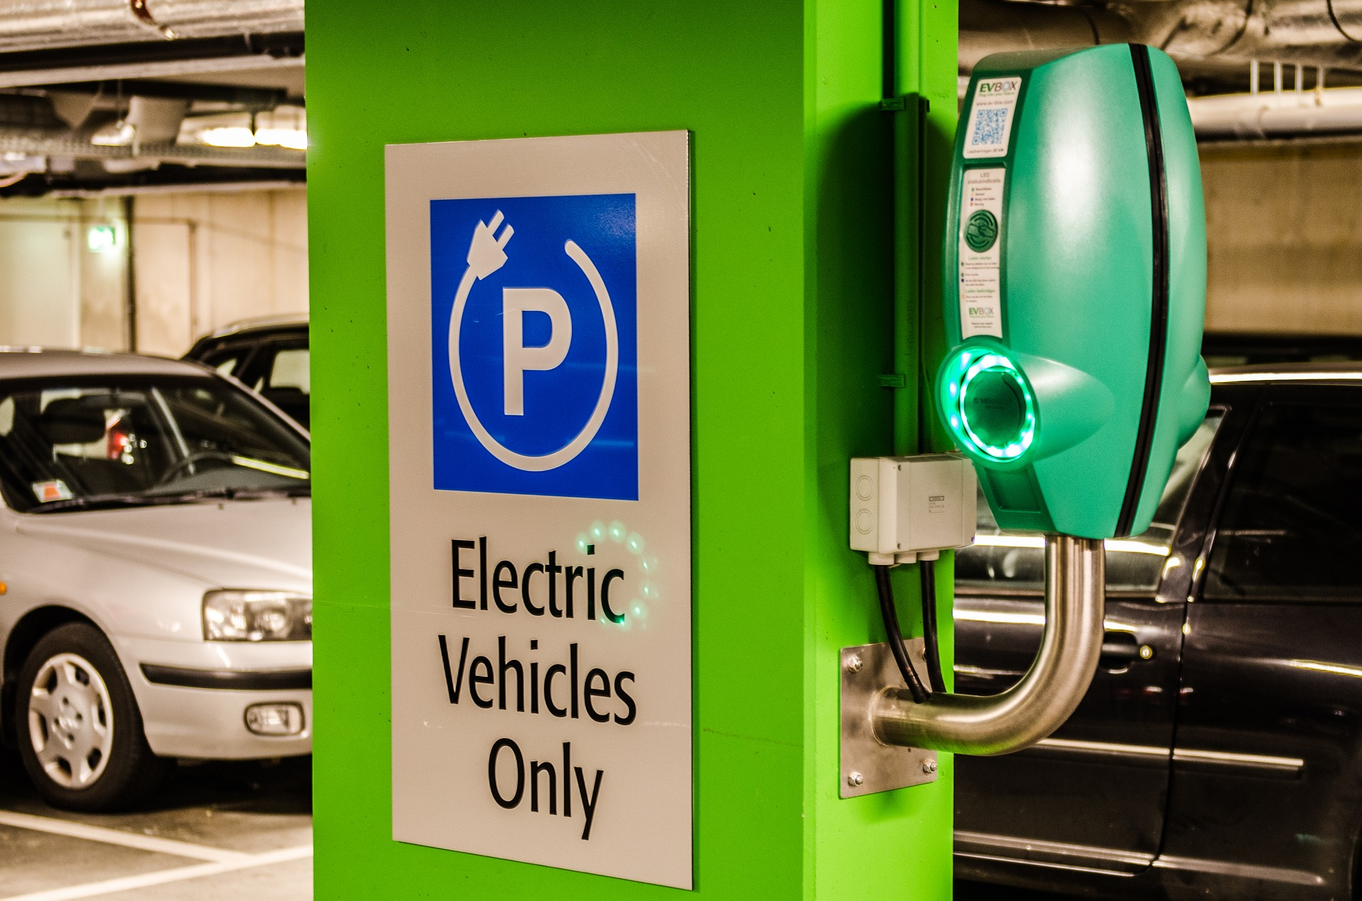
E-Mall
Cause
Global warming
Less use of fuels
And etc.
Users & Systems
EV-drivers -> User
Electric mobility service provider (eMSP) -> System
Charging point operators (CPOs) -> User
Charging point management systems (CPMS) -> System
External System
Distribution System Operators (DSOs) -> External System

Slide 3
RASD (Requirement Analysis and Specification Document)

Slide 4

Goals | Descriptions
G1 | eMSP allows EV-drivers to search for charging stations nearby, their cost, and any special offer.
G2 | eMSP allows EV-drivers to book a charge in a specific charging station 15 minutes before connection.
G3 | eMSP allows EV-drivers to sort the available charging point stations based on the selected filter.
G4 | eMSP allows EV-drivers to rate the charging station they received the service from.
G5 | eMSP allows EV-drivers to add credit to the wallet inside their account for paying later.
G6 | eMSP allows EV drivers to pay for the obtained service either using internal wallet or by credit card.
G7 | CPMS allows CPOs to know about the amount of energy used by each vehicle.
G8 | CPMS allows CPOs to know the “external” status OF charging stations, e.g. location of available charging sockets, type, cost
G9 | CPMS allows CPOs to monitor the charging process to infer when the battery is full
G10 | CPMS allows CPOs to know the “internal” status of a charging station
G11 | CPMS allows CPOs to know the current price of energy acquired from the DSOs
Goals

Slide 5
World/shared phenomena
Shared Phenomea | Descriptions | Control
SP1 | User searches for nearby charging stations | World
SP2 | eMPS shows the nearby stations by default | System
SP3 | User sort the available stations | World
SP4 | eMPS shows the occupied and free sockets of that station (type, cost, etc.) | System
SP5 | eMPS shows the amount of time for the first occupied socket to be freed | System
SP6 | The user books one of the free sockets | World
SP7 | eMPS provides a receipt (QR code) for booking confirmation | System
SP8 | eMPS shows the remaining time of charging to the user | System
SP9 | Users can monitor the charging process of his/her car | World
SP10 | eMPS notifies the user when the charging process is finished | System
SP11 | User pay for the bill | World
World phenomena
* facts that occur in world
Shared Phenomena
* events/facts that occur between system & world
* controlled by system/world
World Phenomena | Descriptions
WP1 | The user finds out that his/her car needs charging
WP2 | User plug in the car
WP3 | The user shows the QR code of booking confirmation to the station

Slide 6
Assumptions
The charging stations always have batteries and/or are supported by DSO
The locations and information of each station that is inserted into eMSP by CPOs, are observed and correct.
The Current price of energy provided by DSO is correct and updated instantly
The comments and rates which are given by every EV-driver for each station are meaningful

Slide 7
Requirements (eMSP vs. CPMS)
eMSP
The eMSP must allow an unregistered user to register
The eMSP must allow users to top-up their virtual wallet to complete payments
The eMSP must show the nearest charging stations
The eMSP must send a notification to the user that the charging process is finished
The eMSP must allow users to pay for the service
The eMSP must allow users to rate charging stations
CPMS
The CPMS must allow CPOs to login
The CPMS allows CPOs to View charging stations’ location
The CPMS Allow CPO to monitor external status
The CPMS allows CPO to monitor the internal status
The CPMS allows CPO to monitor the status of the batteries
The CPMS allows CPO to view the current price of the energy through DSOs

Slide 8
Complete use case
New EV-driver Register
EV-driver sign-in
Search for charging points
Book a socket
eMSP notifies CPMS
Confirmation receipt
(QR-code)
Start charging process
eMSP notifies user charging finished
EV-driver pays (wallet, credit card)
EV-driver rates charging point

Slide 9
Complete use case
A new EV-driver signs up in the eMSP system.
EV-driver logins to the system.
EV-driver searches for charging point stations (nearby, lowest price, highest rate, socket type, and etc.) in eMSP system.
EV-driver books a socket 20 minutes before connection in a charging point.
eMSP notifies CPMS about the new booking and gives confirmation receipt to EV-driver.
Charging process is started by connecting the vehicle to the socket.
eMSP notifies EV-driver when charging process is finished.
EV-driver pays for the service either from internal wallet credit or using credit card.
EV-driver rates the charging station.

Slide 10
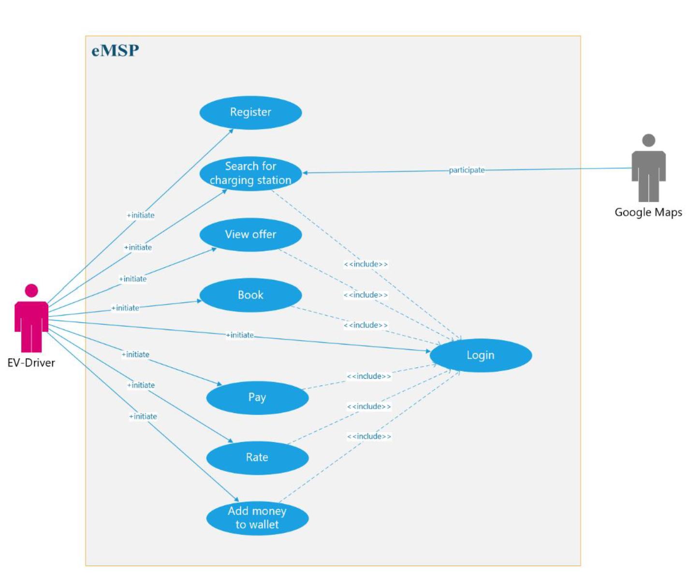
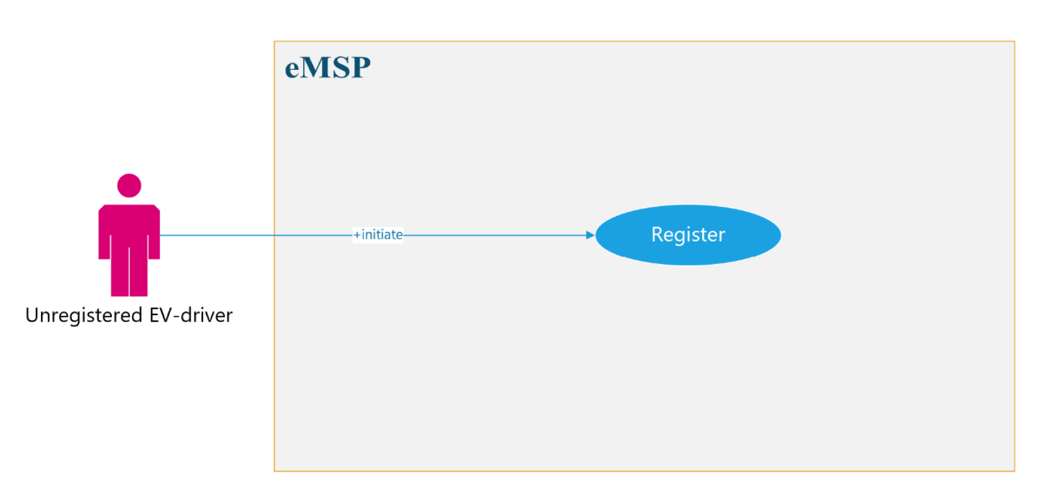
Use case Diagrams (EV-driver)

Slide 11
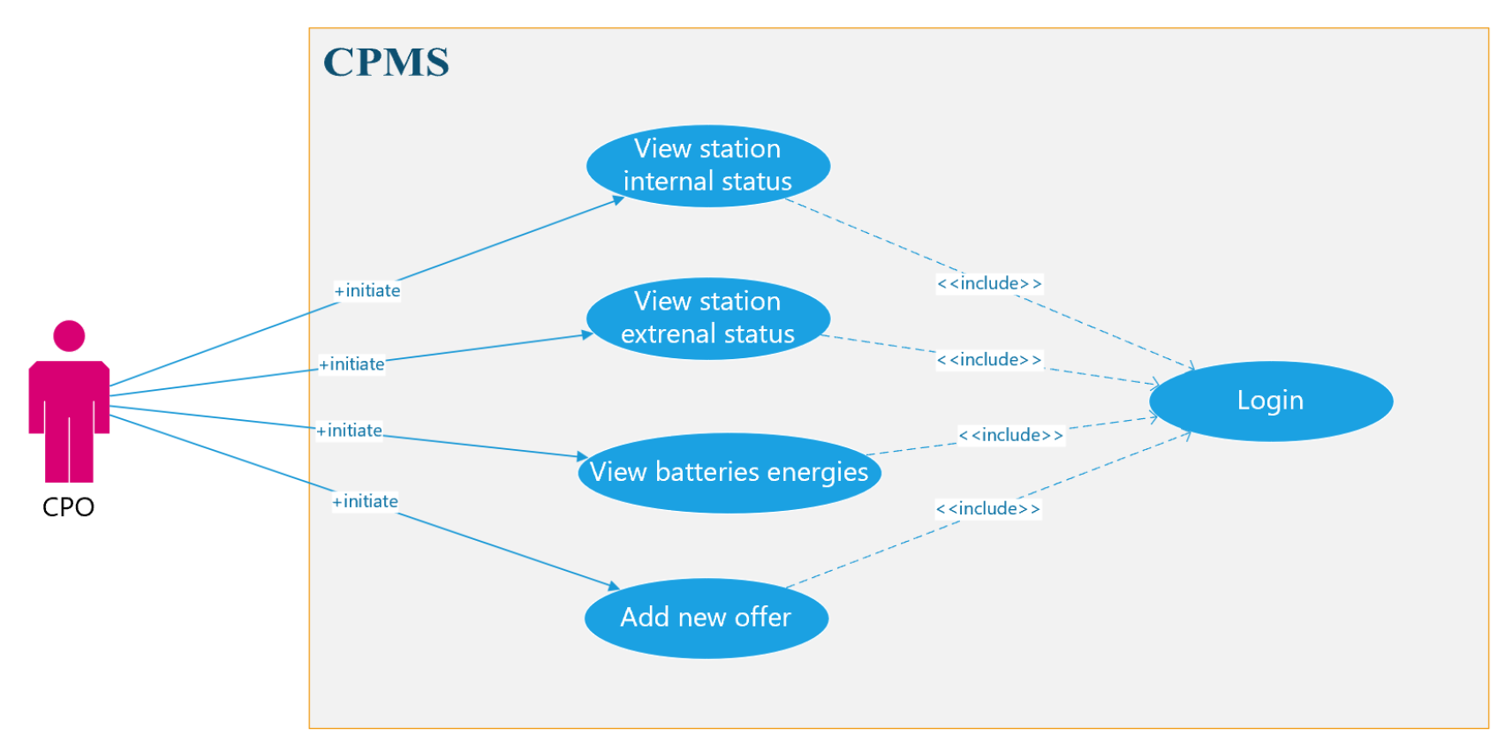
Use case Diagrams (CPO)

Slide 12
Class Diagram

Slide 13
ALLOY
Some important signatures
Some important facts
EV-driver
Wallet
vehicle
CPO
Charging station
Socket
battery
DSO
battery
Charging session
Booking
Payment
Each user has one wallet.
Each DSO wors with multiple charging stations.
Each charging station is linked to at least a CPO.
Each socket is linked to at least a charging station.
Each charging session is linked to a booking.
Each charging session must be linked to only one payment.
Each payment must be linked to only one offer.

Slide 14
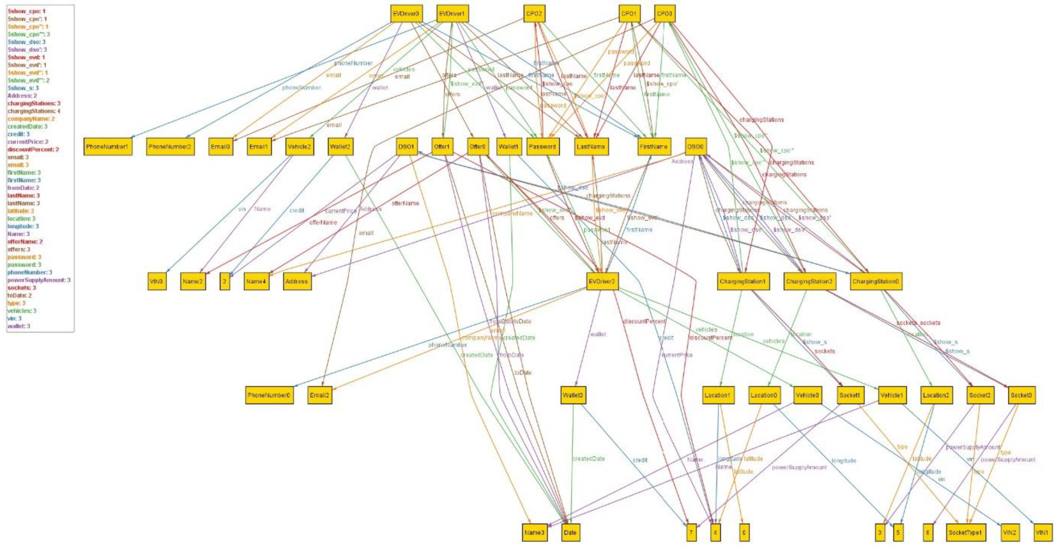

Slide 15
DD (Design Document)

Slide 16
Components
2 Systems
CPMS -> which CPO works with
eMSP -> which EV-driver works with
These two systems are linked via an external API connection interface
External components
Mobile Applications (USER & CPO)
Google Map Services
Bank System
Data Base Management System (DBMS)

Slide 17
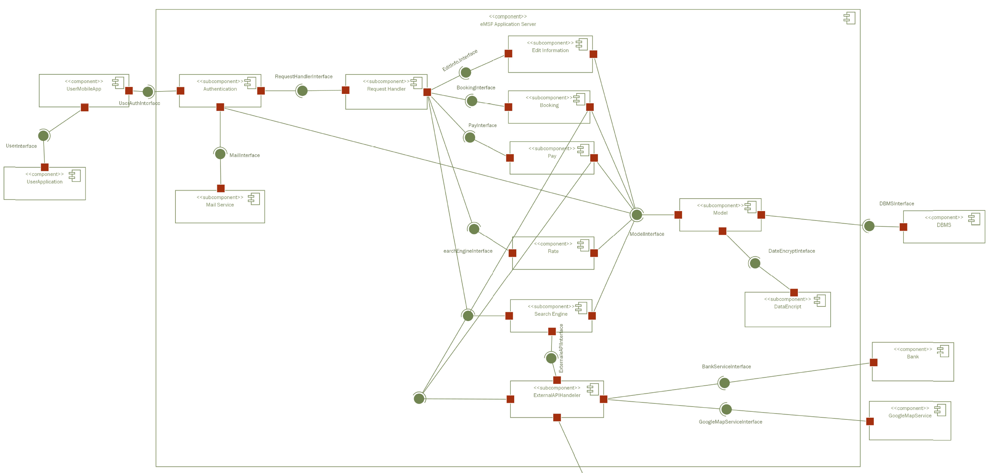
Component Diagram (eMSP)

Slide 18
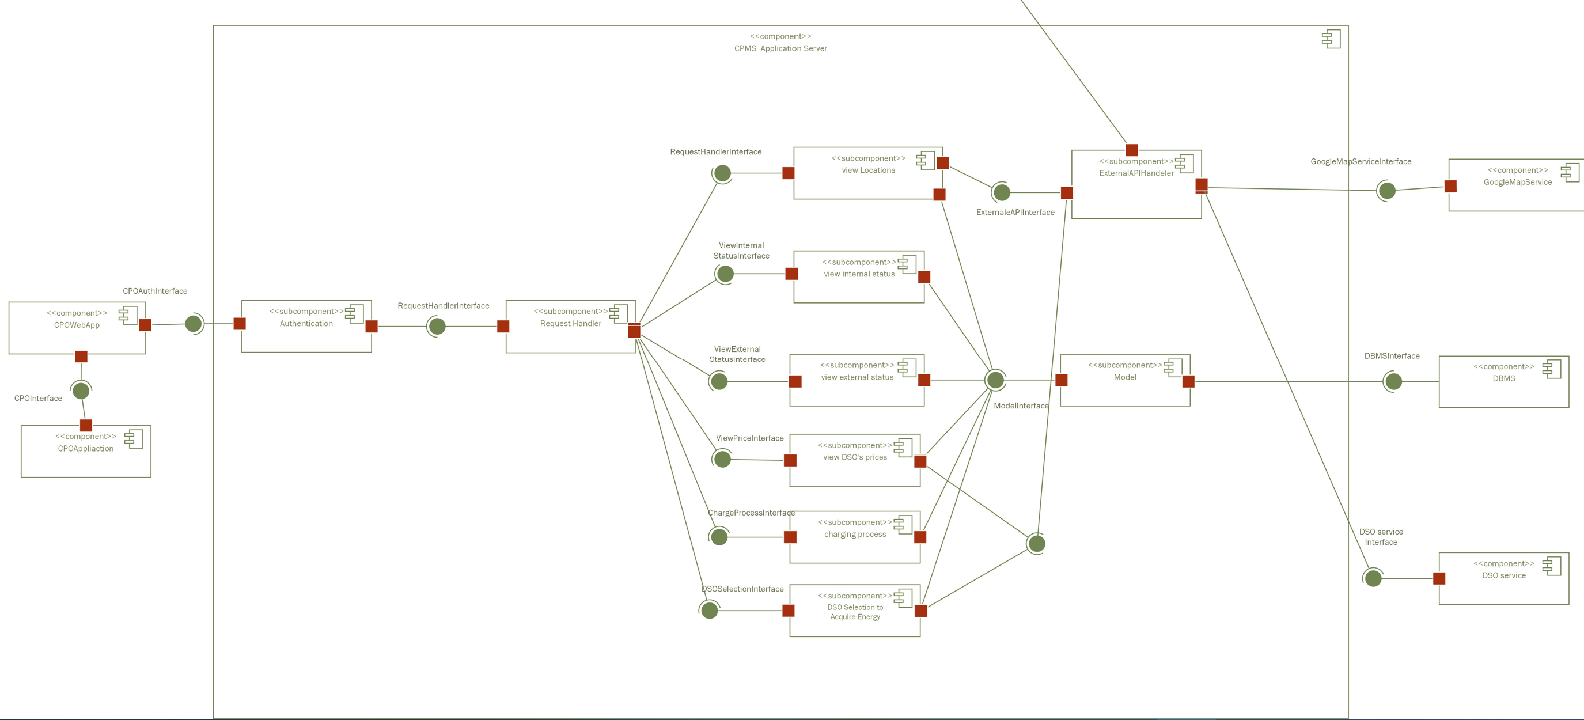
Component Diagram (CPMS)

Slide 19
External Interfaces & Interactions
eMSP interacts with:
Google Map Services
-> for navigation & searching process
Bank System
-> to complete payments
Data Base Management System(DBMS)
CPMS
-> to notify CPMS about any new booking
CPMS interacts with:
Google Map Services
-> for navigation & searching process
Data Base Management System(DBMS)
eMSP
-> to notify other eMSPs if any time slot or socket has been booked

Slide 20
Architectural Design
Presentation tier
User interface
Communication layer
Application tier
Logic tier
Data tier
Database
Backend
eMSP/CPMS

Slide 21
Architectural styles and patterns
MVC
Model
Controller
View
security
HTTP
External Interactions
JSON
Transmitting data
TLS
Exchange messages
REST

Slide 22

Implementation and Testing

Slide 23
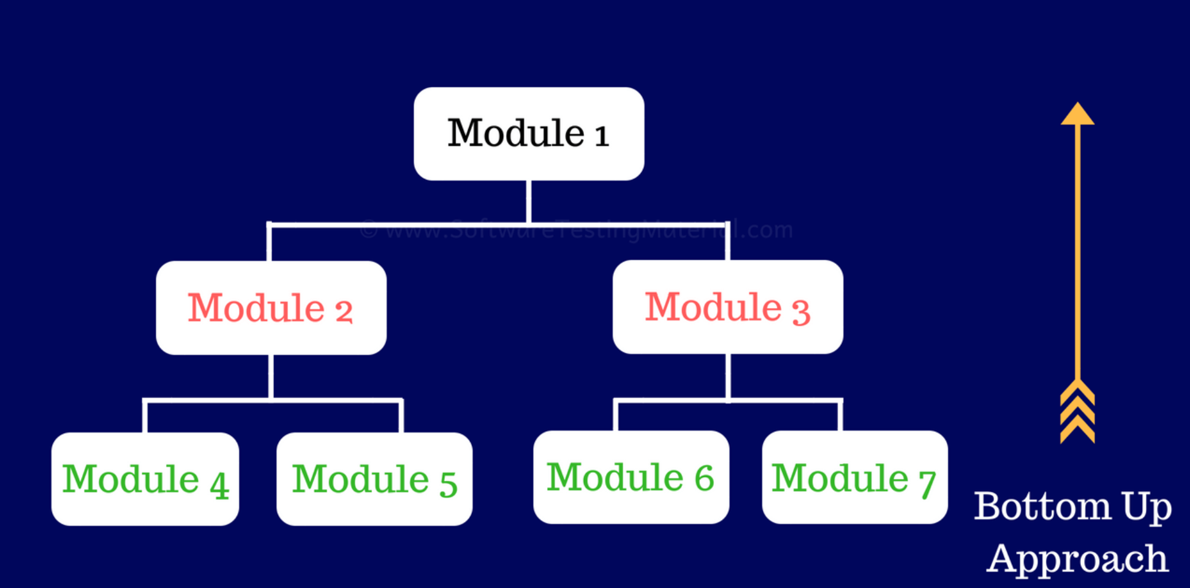
Implementation and Testing

Slide 24
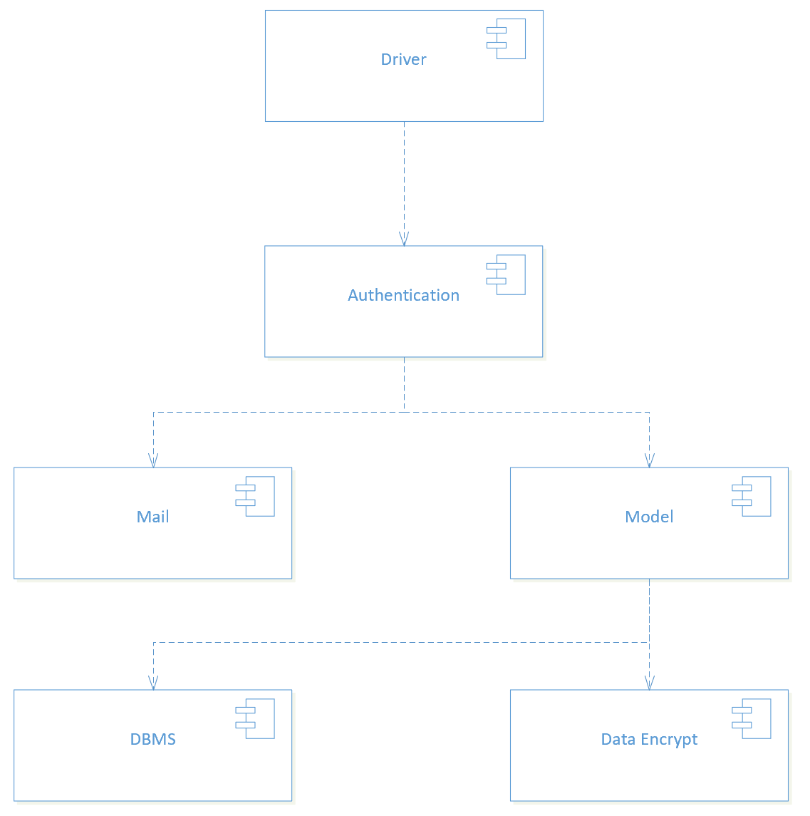
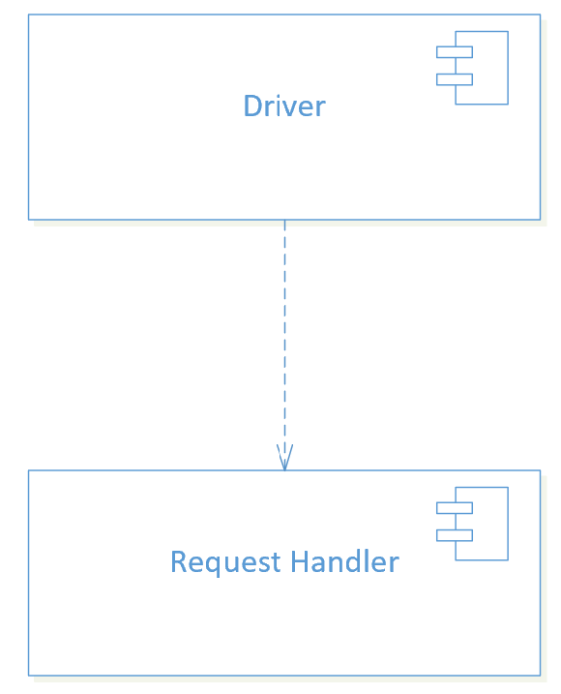
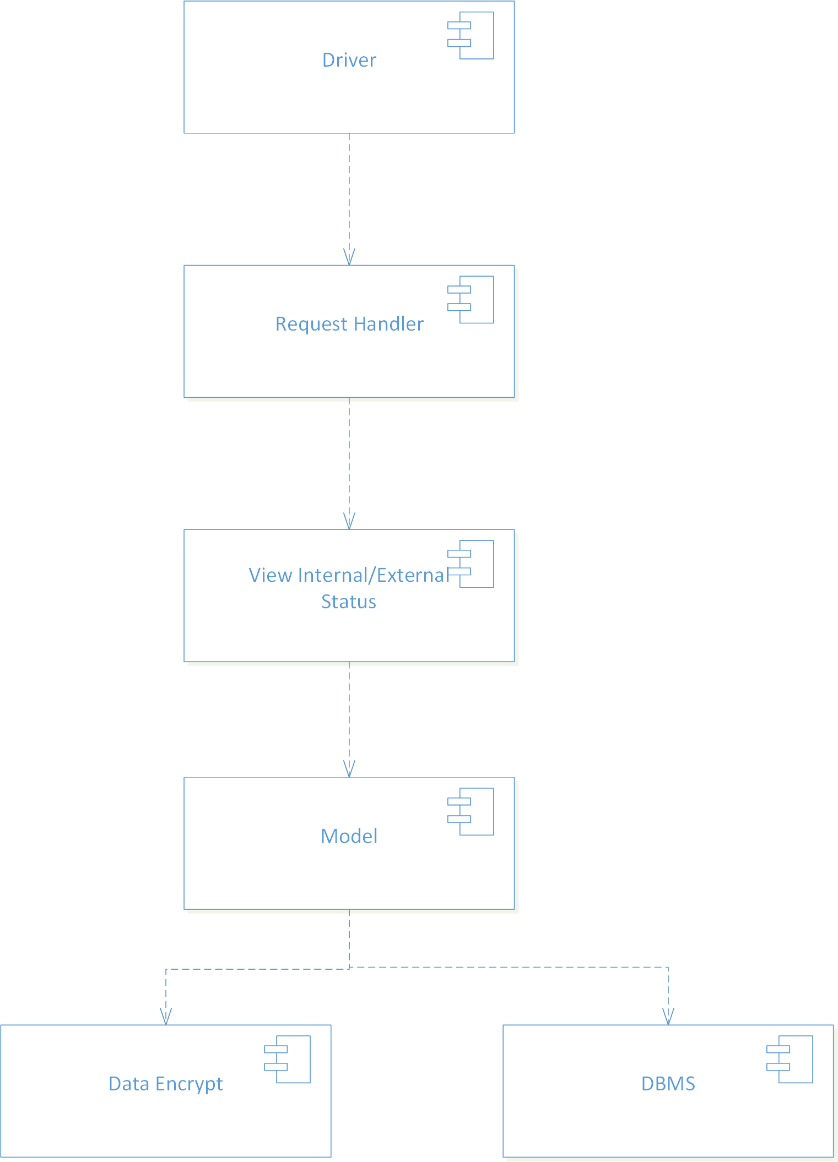
eMSP
Authentication
Request Handler
CPMS
View Internal/External status

Slide 25
Thank you for your attention

